Slide 1
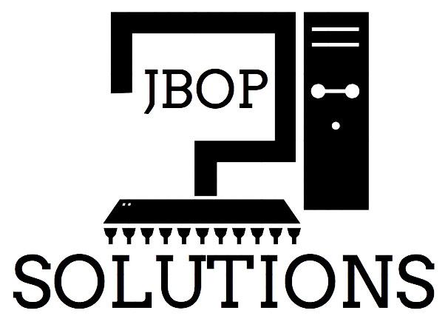

Satellite Shade Analysis
JBOP Solutions:
Taylor Born, Ben Johnson, Steffen Olson, and Rachel Pang
November 19, 2013

Slide 2
Who we are:
Taylor Born
Lead Algorithm Engineer
Ben Johnson
Team Leader
Document Manager
Steffen Olson
Webmaster
Rachel Pang
Sponsor and Mentor Contact

Slide 3
The Problem

Slide 4
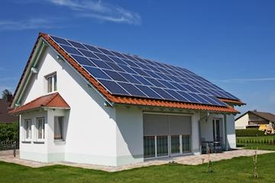
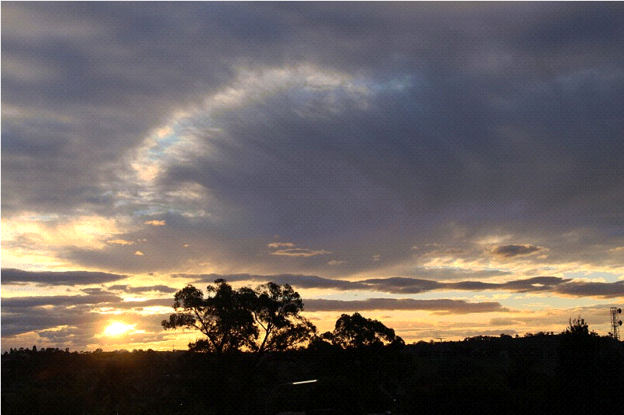
The Problem
Rooftop Solar
  Seth Holland - Co-Founder
  Installation, Marketing, and Sales of solar modules
  Become green

Slide 5
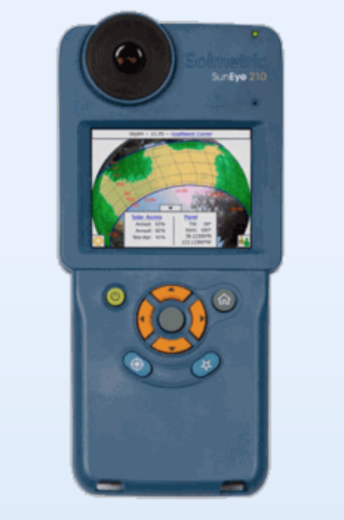
Current Process
Send people on-site to survey the area using handheld SunEye machines
Machine is placed where a solar panel could be
  Checks obstructions
  Calculates the percentage of sunlight
Requires time, money, and company resources
Rooftop Solar gets 30-40 clients a month that need this done.

Slide 6
The Solution

Slide 7
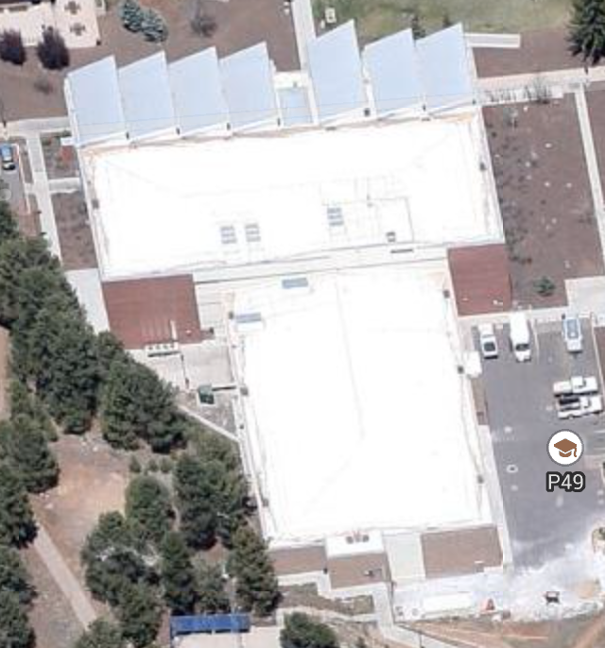

The Solution
Create a web application that works with Google Maps to estimate how much shade a solar module would get
This method is
  Faster
  More cost effective
  Safer for workers
Plans to license this product
  Solve entire industry’s problem
  Is not limited to one company

Slide 8
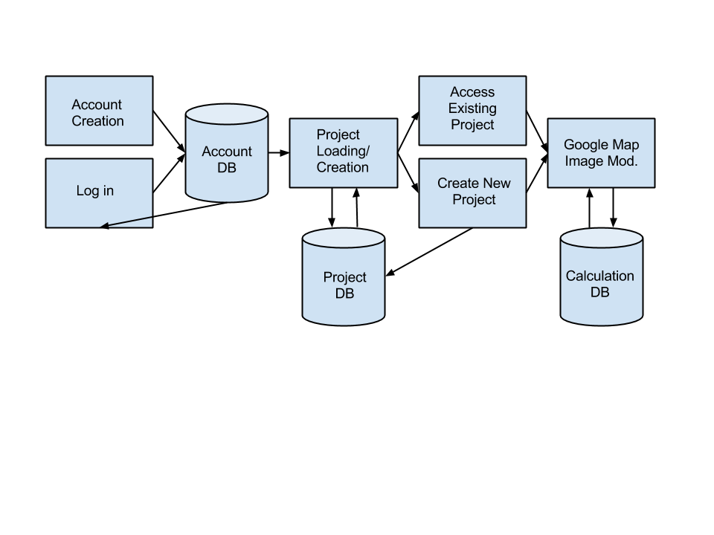
Current Architecture

Slide 9
Functional Requirements

Slide 10
Functional Requirements
User Management
Project Management
Display an Interactive Map
Calculate Shade Percentage
Display Results
Notes:
User Management
User account creation / deletion
Login / logout
Project Management
Create/Delete projects
Load existing
Edit
Interactive Map
Display a map, zoomed to a user specified address
Also display a corresponding street view, if available
User can draw objects on map (trees/buildings/etc)
Possibly Auto-detect obstructions
User specifies location of solar modules on the roof
Calculate Shade Percentage
User clicks a “Compute” button.
Calculations run
Display Results
Comprehensive result page
Break down of shade percentage by year/month/etc...

Slide 11
Environmental Requirements

Slide 12
Environmental Requirements
Web Based
Map Integration
Tools
  Google Maps API
  Javascript
  HTML
  CSS
  MySQL
Notes:
Web Based
Need a web based solution, so rooftop can easily sell the product later
Server space will be provided as the project nears completion
Map Integration
Tools

Slide 13
Non-Functional Requirements

Slide 14
Non-Functional Requirements
Algorithm results are accurate within 3%
    Suitable replacement
    Good assessment for customers
Inputting interface should have high usability
    Easily comprehendible by users
    Uncomplicated process in preparing algorithm
    Unintended meaning does not influence results

Slide 15
Potential Risks

Slide 16
Potential Risks
Risk | Severity | Mitigation Strategy
Algorithm’s accuracy | Whether solution is viable | Algorithm building and testing will be iterative and ongoing. Will be compared with real results
User system and database security | Customer confidentiality trust | Permission and access rights will be implemented through the database (MySQL), and storage will be on a secure site

Slide 17
Project Plan

Slide 18
Project Plan

Slide 19
Project Plan

Slide 20

Conclusion
There is a severe inefficiency on how much time, effort, and manpower is needed to give a customer a shade estimate
Our solution can potentially change how efficient shade analysis will be done in the future, including future companies

Slide 21
Thank You!

Slide 22
Hyperlinks to Previous Pages
Homepage
Who We Are
The Problem
The Solution
Functional Requirements
Environmental Requirements
Non-Functional Requirements
Potential Risks
Project Plan

Slide 23
Image Sources (In order of appearance):
http://www.rooftopsunpower.com
http://newscenter.lbl.gov/news-releases/2011/09/15/tracking-the-sun-iv/
http://www.pbase.com/image/111823673
http://www.solmetric.com/
http://maps.google.com
http://solartribune.com/your-home/

